Slide 1
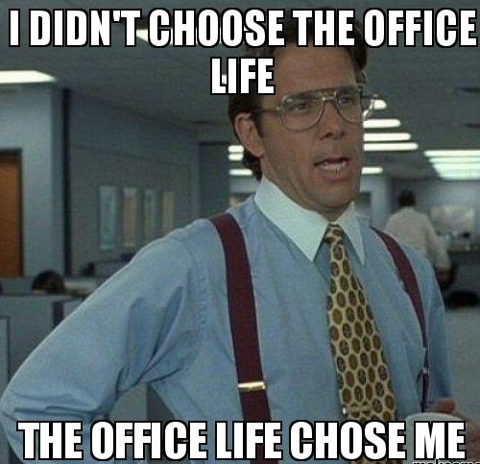
WHAT NOT TO DO IN THE OFFICE
-By SOHAM PAL
(XBBNH7S)

Slide 2
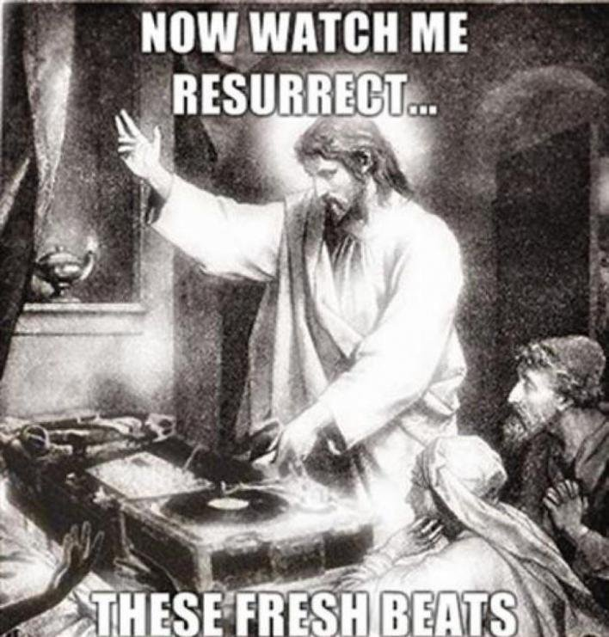
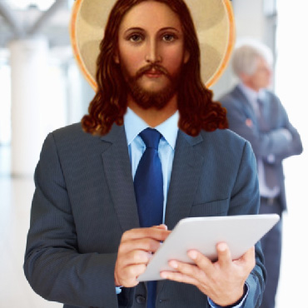
Everyday, we live in TWO WORLDS
PRIVATE WORLD CORPORATE WORLD

Slide 3
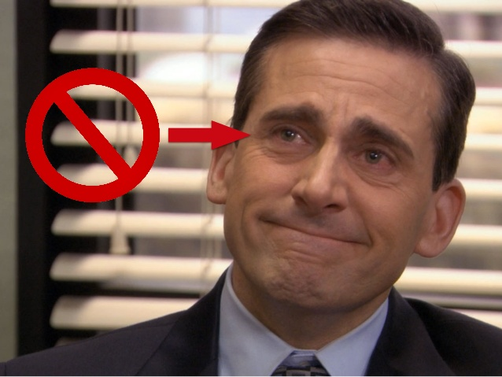
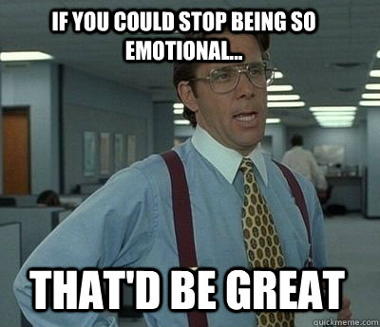
Control your Emotions

Slide 4

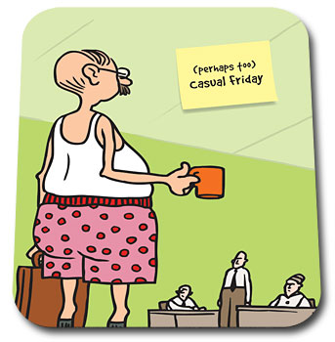
CASUAL FRIDAYS

Slide 5
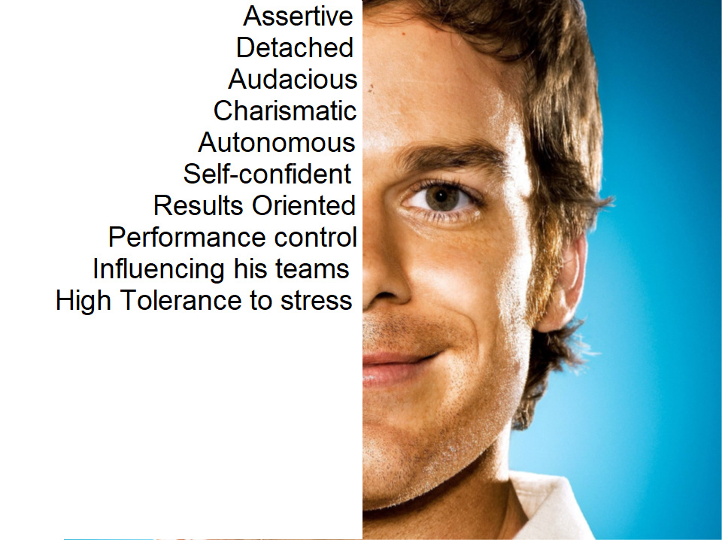
Qualities of perfect employee

Slide 6
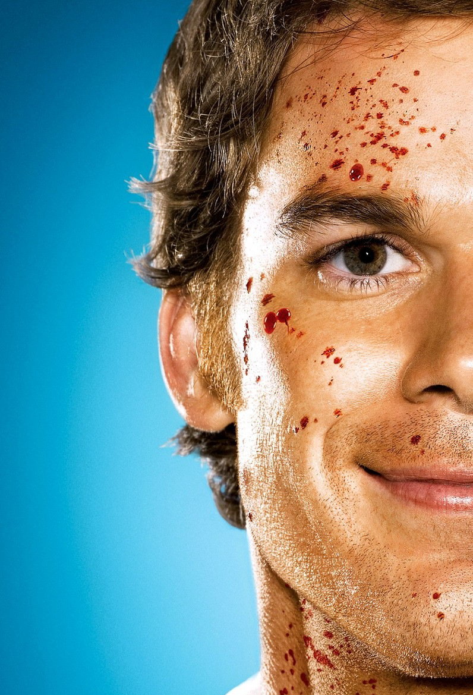
Qualities NOT of perfect employee
PSYCOPATH
Not thinking of what people might think of them and manipulating them to do your work

Slide 7
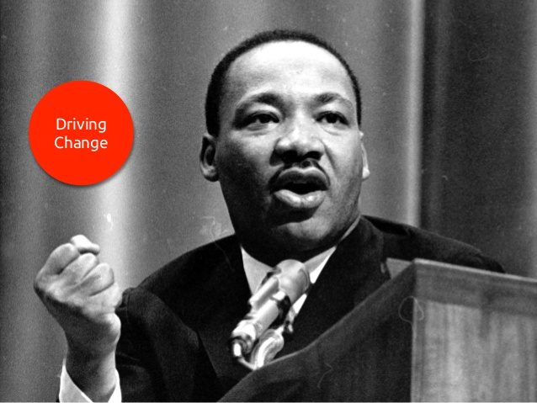

Slide 8
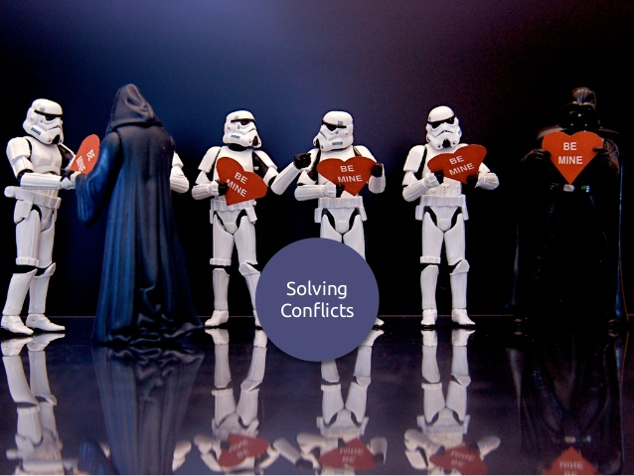

Slide 9


Slide 10
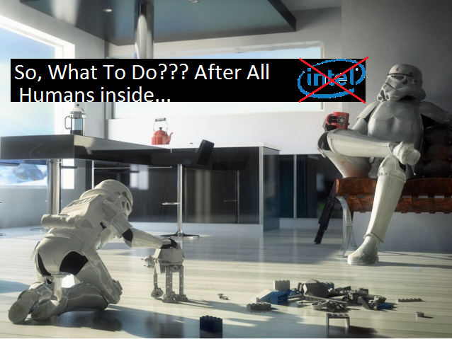

Slide 11
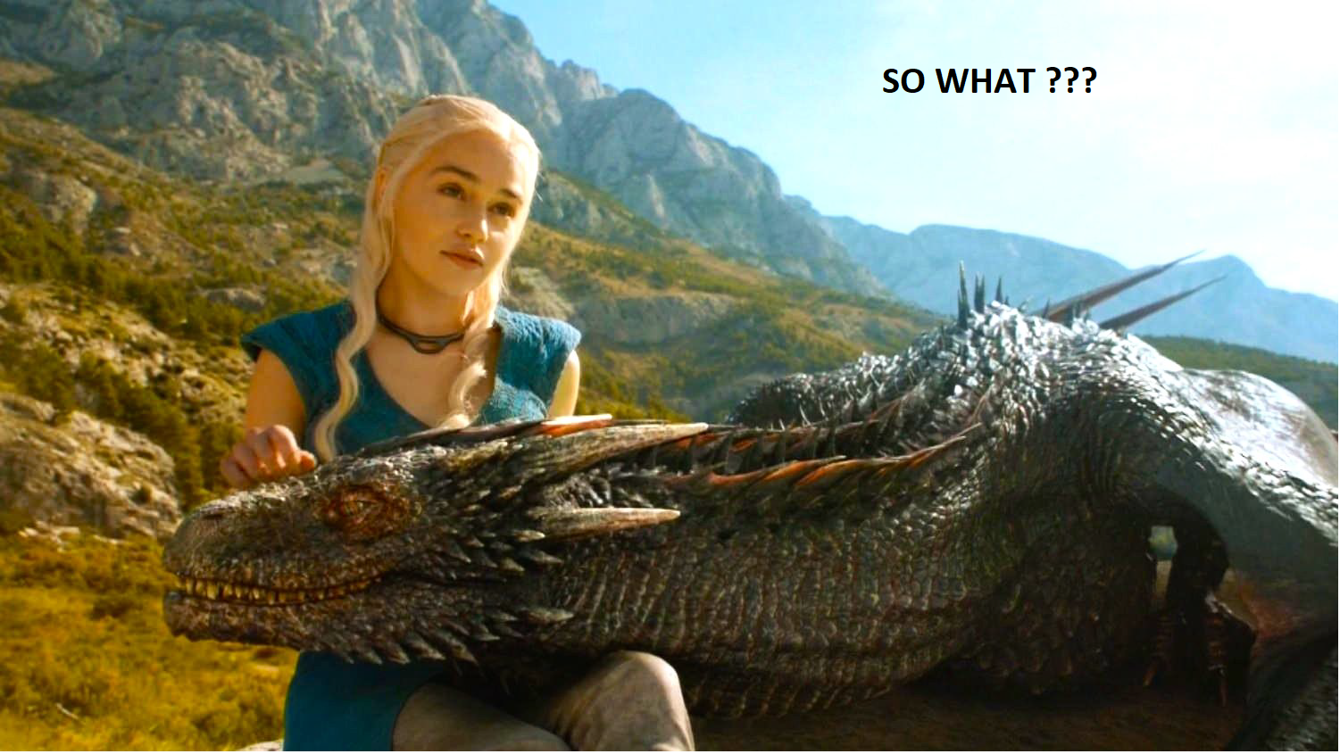

Slide 12
There’s a fine gap between emotional stupidity and IQ
--Daniel goleman

Slide 13
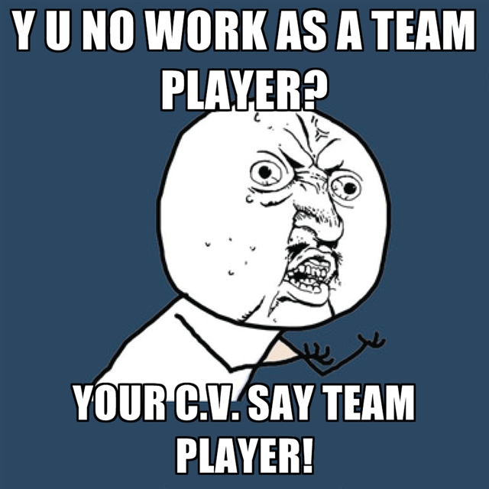
BE A TEAM PLAYER

Slide 14
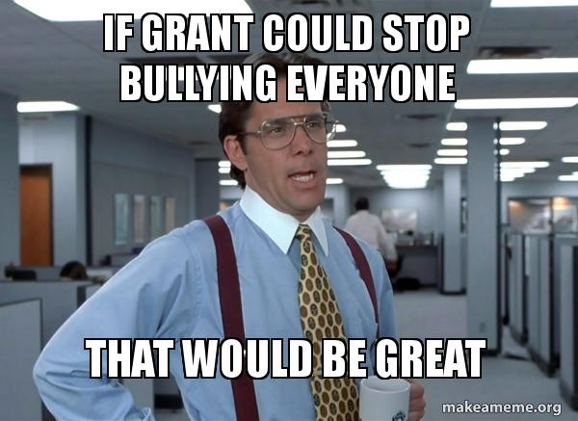
NO WORKPLACE BULLYING OR RUDE COMMENTS

Slide 15
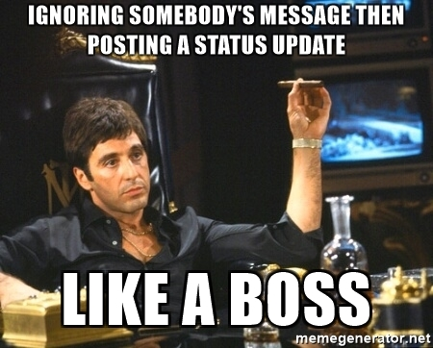
DON’T IGNORE YOUR BOSS’ LYNC MGS

Slide 16

DON’T GIVE IN
TO THE
DARK DESIRES

Slide 17
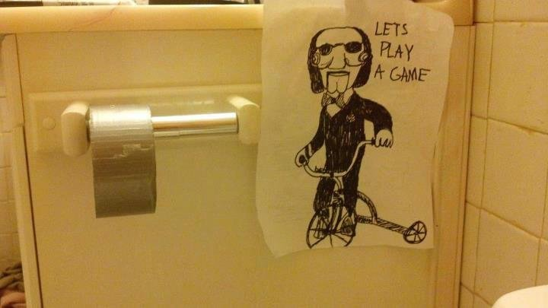

Slide 18
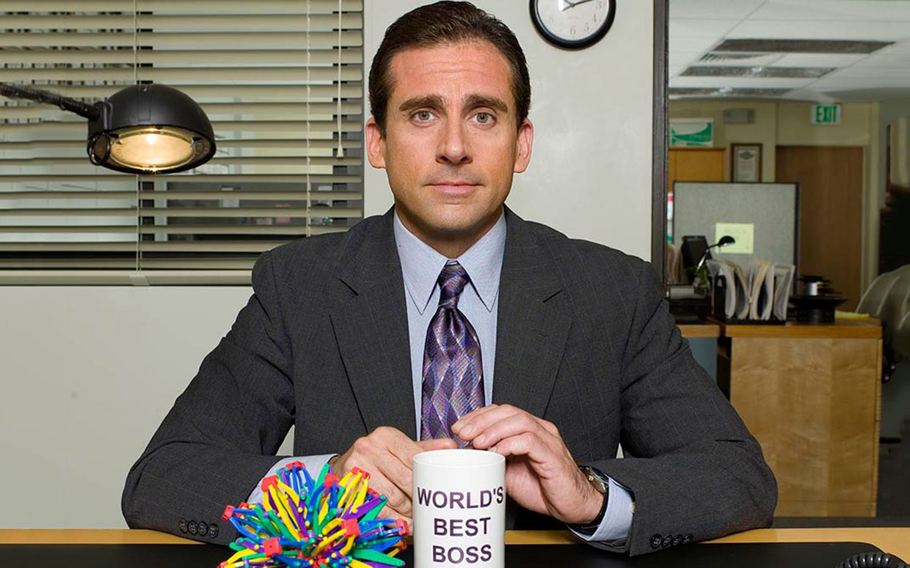
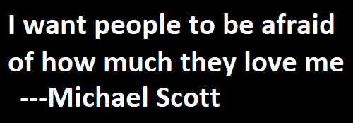

Slide 19
Thank you (only for those who are awake)

Slide 20


